Slide 1
Resultados GVAR-IIS

Slide 2
Modelos
GVAR-IIS
GVAR
VECM
PCA

Slide 3
GVAR vs GVAR-IIS (analise primeiro estagio)
Todas as regiões apresentaram um melhor critério de seleção quando comparados com suas versões sem saturação de dummies e seleção automática.

Slide 4
 | AIC | BIC | HQ
Min | 16,02 | 18,91 | 17,18
1st Q. | 24,08 | 26,98 | 25,24
Median | 26,66 | 29,57 | 27,83
Mean | 26,90 | 29,80 | 28,07
3st Q. | 29,39 | 32,30 | 30,55
Max | 43,10 | 46,01 | 44,27
 | AIC | BIC | HQ
Min | 5,23 | 9,20 | 6,83
1st Q. | 22,16 | 23,45 | 22,71
Median | 25,27 | 26,45 | 25,74
Mean | 25,35 | 26,55 | 25,84
3st Q. | 28,32 | 29,32 | 28,71
Max | 42,53 | 43,32 | 42,85
SEM IIS
COM IIS

Slide 5
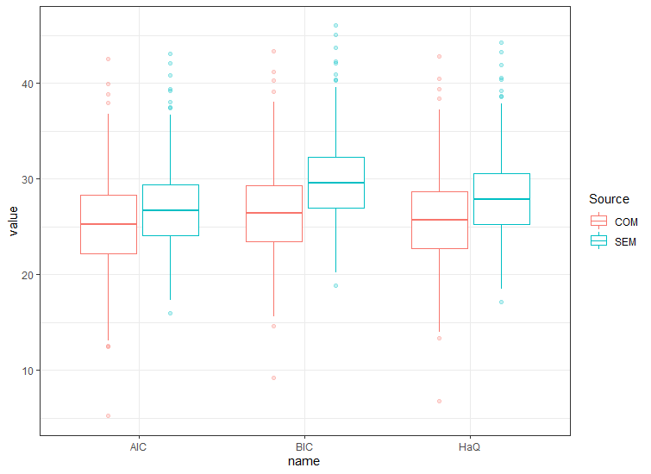

Slide 6

Modelo VECM
Para cada região temos a estimação do seguinte modelo
$${\left[\begin{matrix}ΔADM \\ ΔDES\end{matrix}\right]}_{t}=α_{0}+\left[\begin{matrix}p_{11} & p_{12} \\ p_{21} & p_{22}\end{matrix}\right]{\left[\begin{matrix}ADM \\ DES\end{matrix}\right]}_{t−1}+\sum_{k=1}^{13}{{\left[\begin{matrix}b_{11,k} & b_{12,k} \\ b_{21,k} & b_{22,k}\end{matrix}\right]\left[\begin{matrix}ΔADM \\ ΔDES\end{matrix}\right]}_{t−k}}+e_{t}$$

Slide 7

Modelo PCA
Para cada região temos a estimação do seguinte modelo
$${\left[\begin{matrix}ΔADM \\ ΔDES\end{matrix}\right]}_{t}=α_{0}+\sum_{k=1}^{13}{{\left[\begin{matrix}b_{11,k} & b_{12,k} \\ b_{21,k} & b_{22,k}\end{matrix}\right]\left[\begin{matrix}PCA_1 \\ PCA_2\end{matrix}\right]}_{t−k}}+e_{t}$$

Slide 8
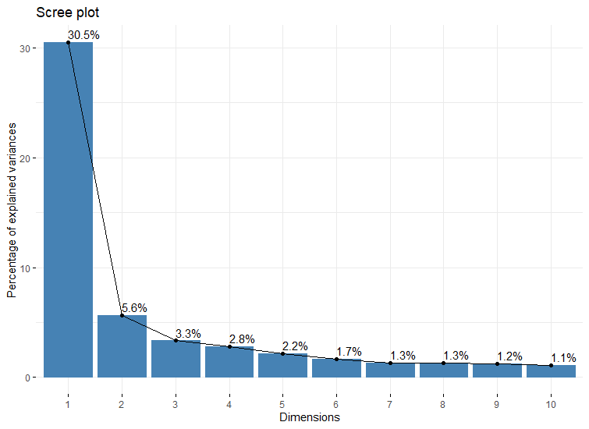

Slide 9

Analise de modelos
4 métricas MSE
$MSE_Overall=\frac{\sum_{t}{\sum_{i}{e_{i, t}^{2}}}}{NT}$
$MSE_Adm=\frac{\sum_{t}{\sum_{i}{adm_e_{i, t}^{2}}}}{NT}$
$MSE_des=\frac{\sum_{t}{\sum_{i}{des_e_{i, t}^{2}}}}{NT}$
$MSE_Net =\frac{\sum_{t}{\sum_{i}{{\left(adm_e_{i, t}^{}−des_e_{i, t}^{}\right)}^{2}}}}{NT}$

Slide 10

Analise de modelos
4 métricas MAE
$MAE_Overall=\frac{\sum_{t}{\sum_{i}{{|e}_{i, t}^{}|}}}{NT}$
$MAE_Adm=\frac{\sum_{t}{\sum_{i}{|adm_e_{i, t}^{}|}}}{NT}$
$MAE_des=\frac{\sum_{t}{\sum_{i}{|des_e_{i, t}^{}}|}}{NT}$
$MAE_Net =\frac{\sum_{t}{\sum_{i}{{|\left(adm_e_{i, t}^{}−des_e_{i, t}^{}\right)}^{}|}}}{NT}$

Slide 11
MSE RESULTS

Slide 12
 | PCA | VECM | GVAR | GVAR-IIS
Overall | 1669,26 | 1079,98* | 1252,23 | 1096,24
Adm | 1899,52 | 1231,78 | 1377,34 | 1188,99 *
Des | 1401,66 | 903,01* | 1113,15 | 994,884
Net | 2250,62 | 1333,88 | 1500,025 | 1248,01*

Slide 13
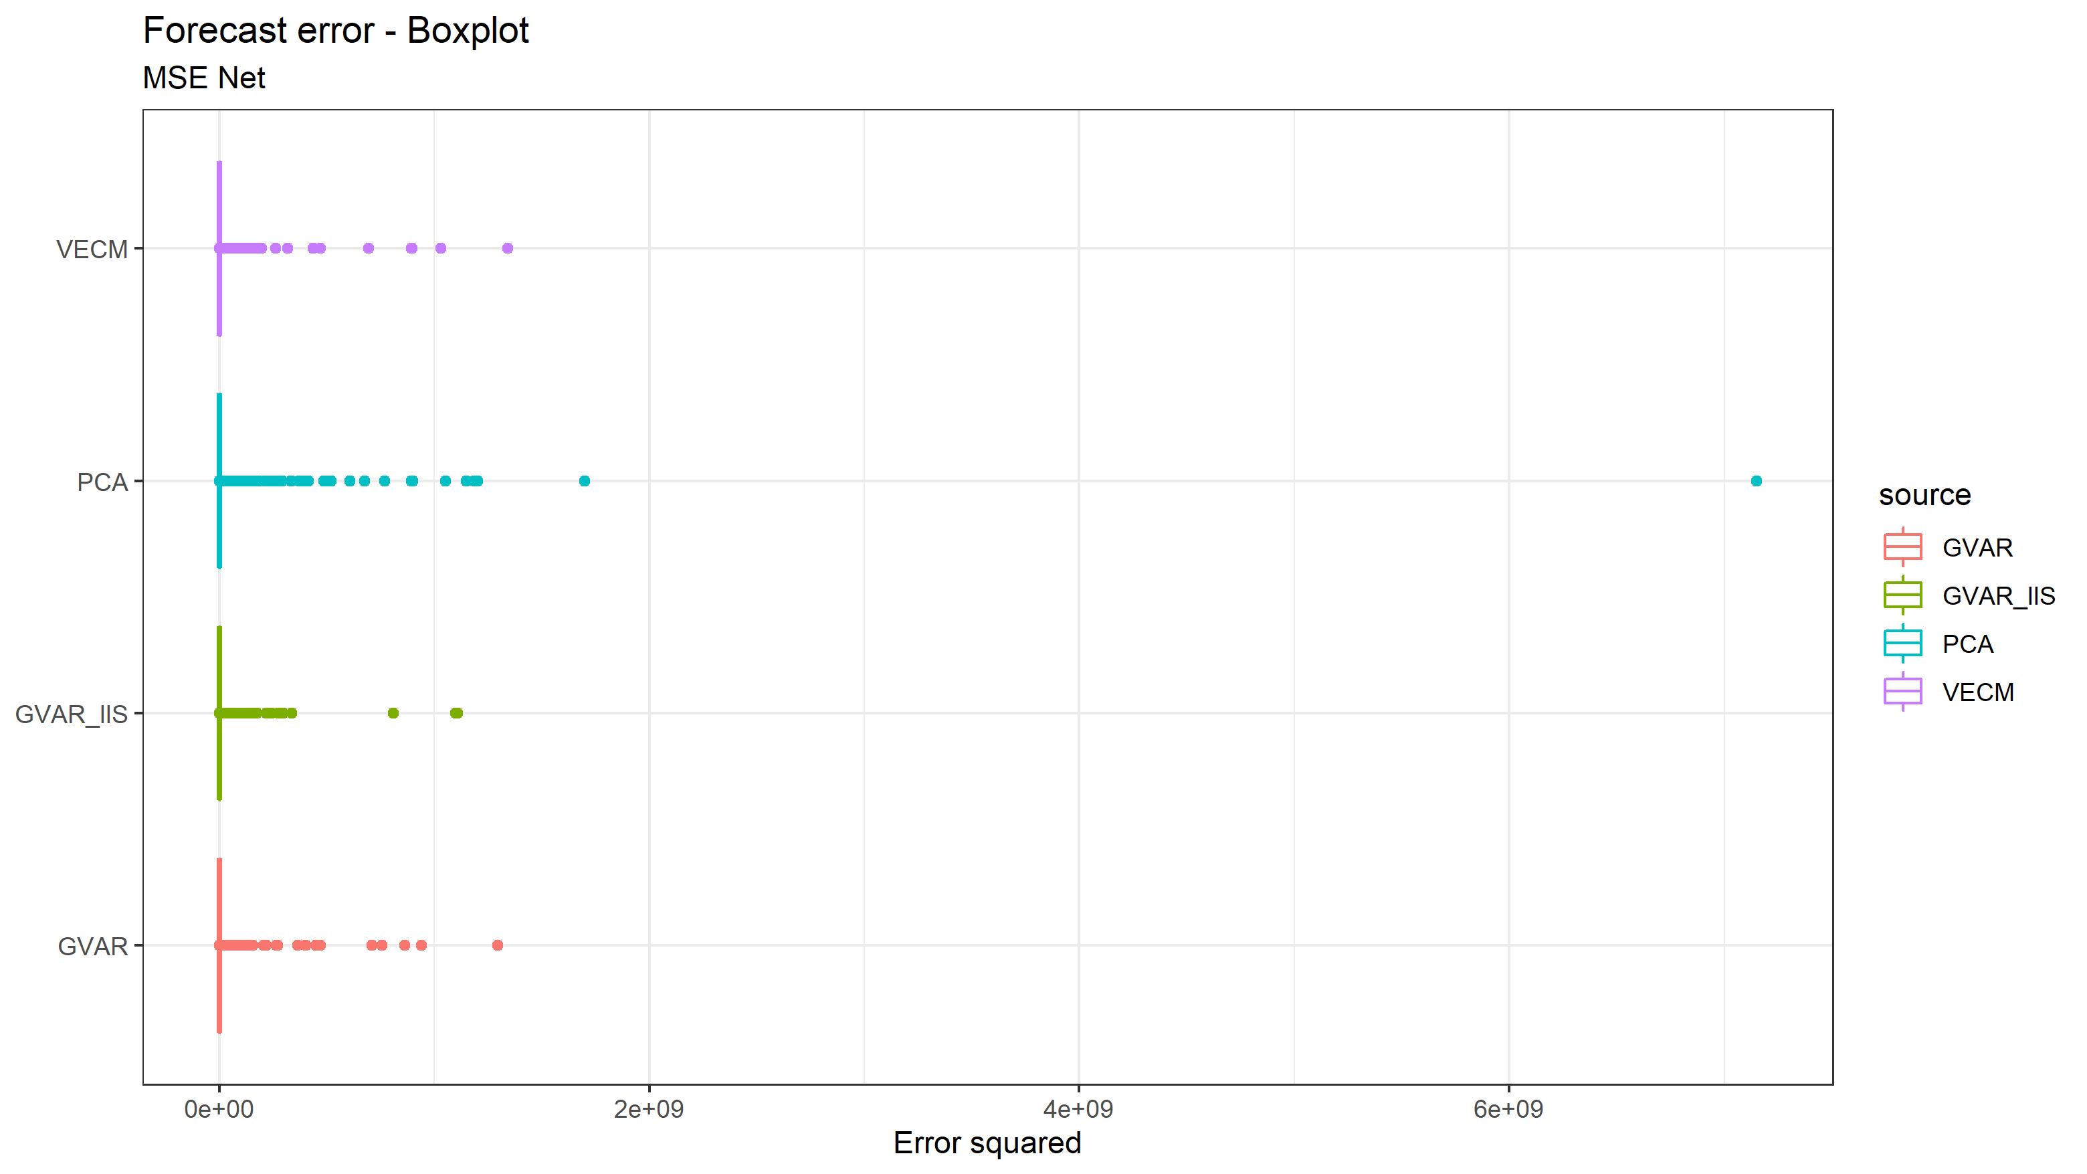

Slide 14
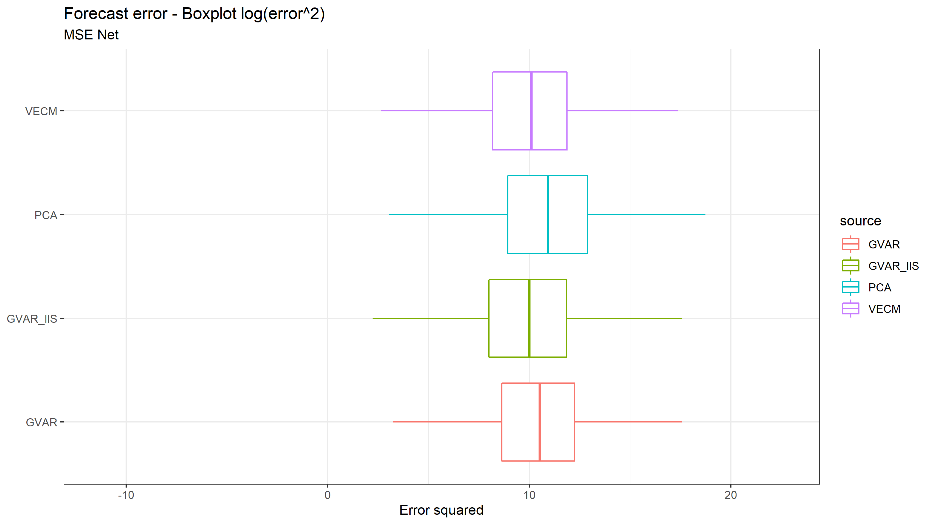

Slide 15
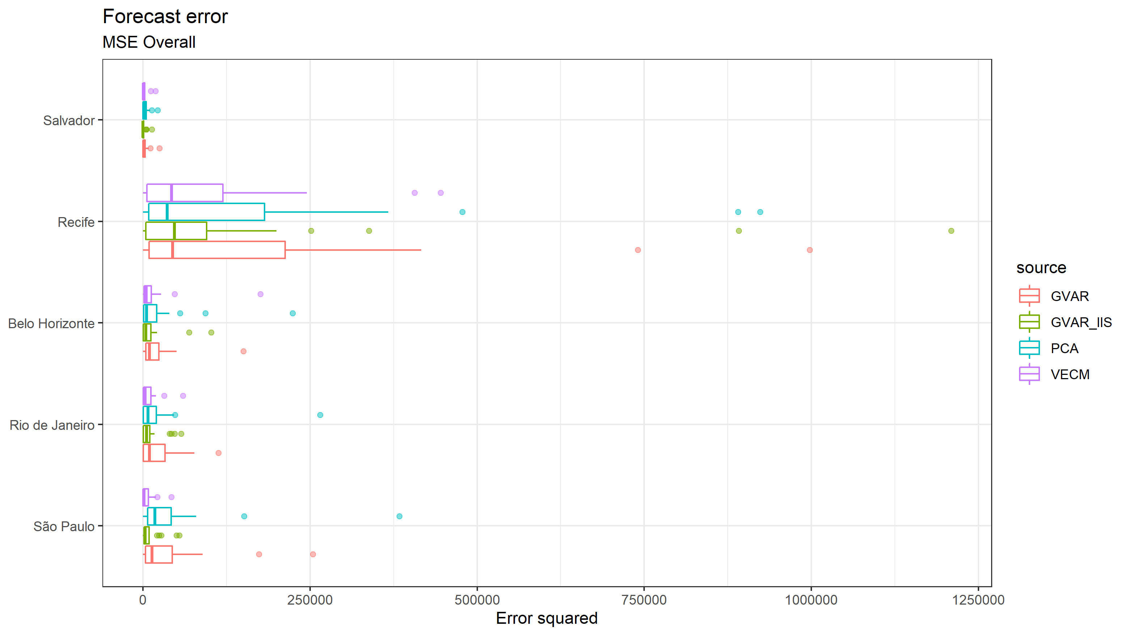

Slide 16
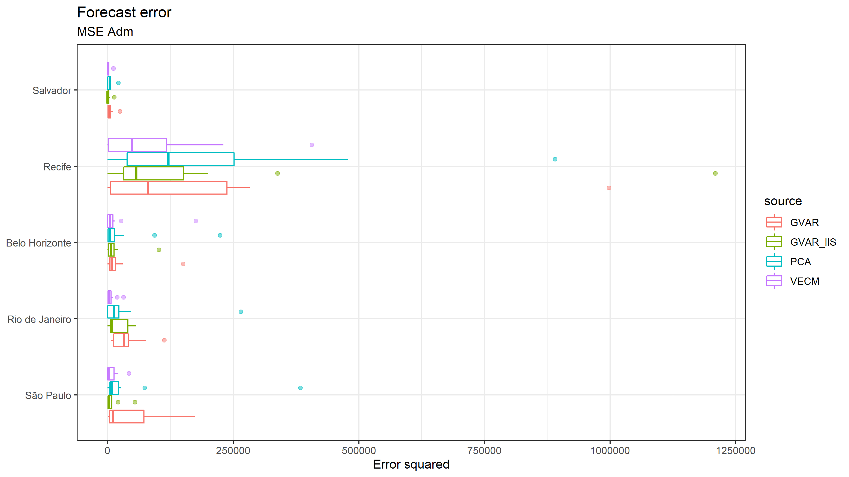

Slide 17
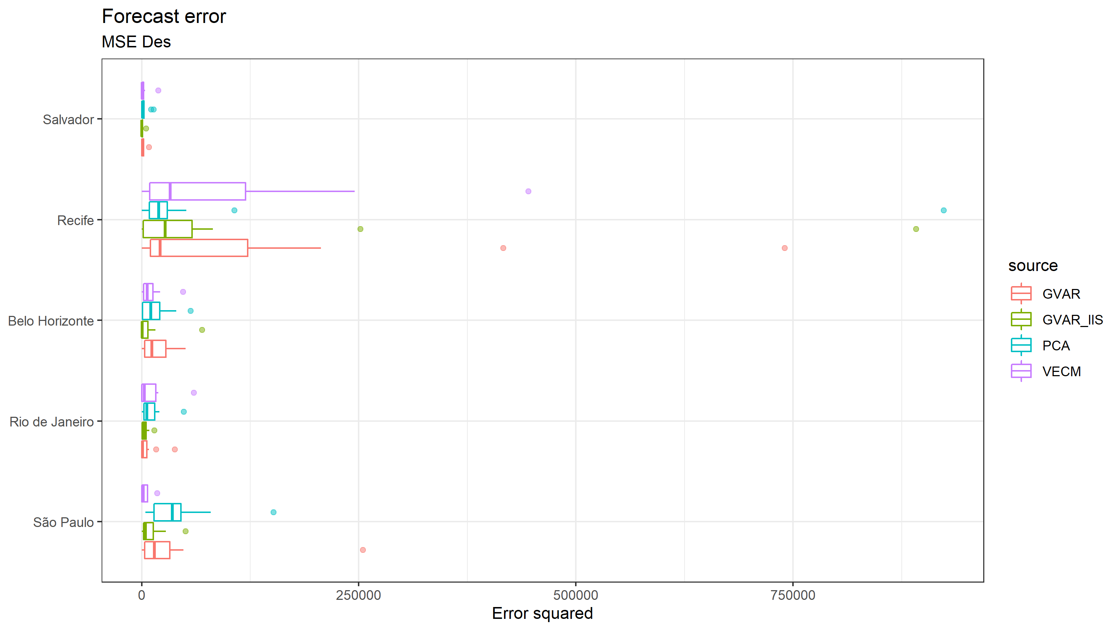

Slide 18
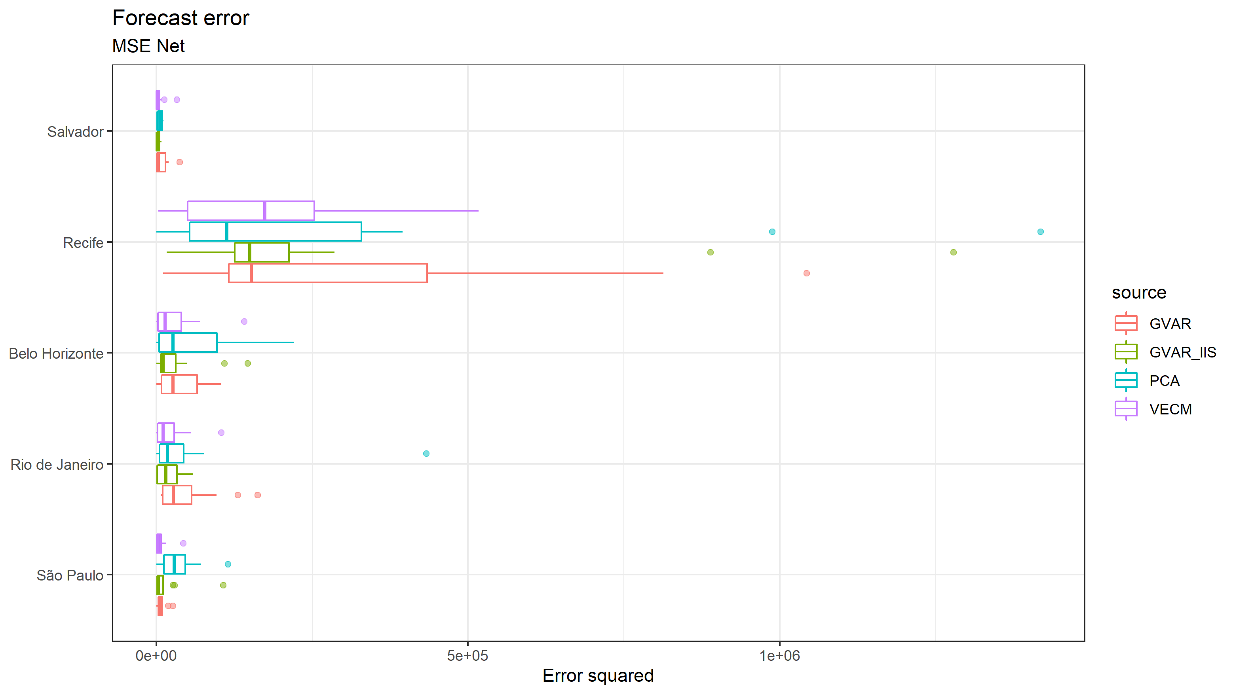

Slide 19
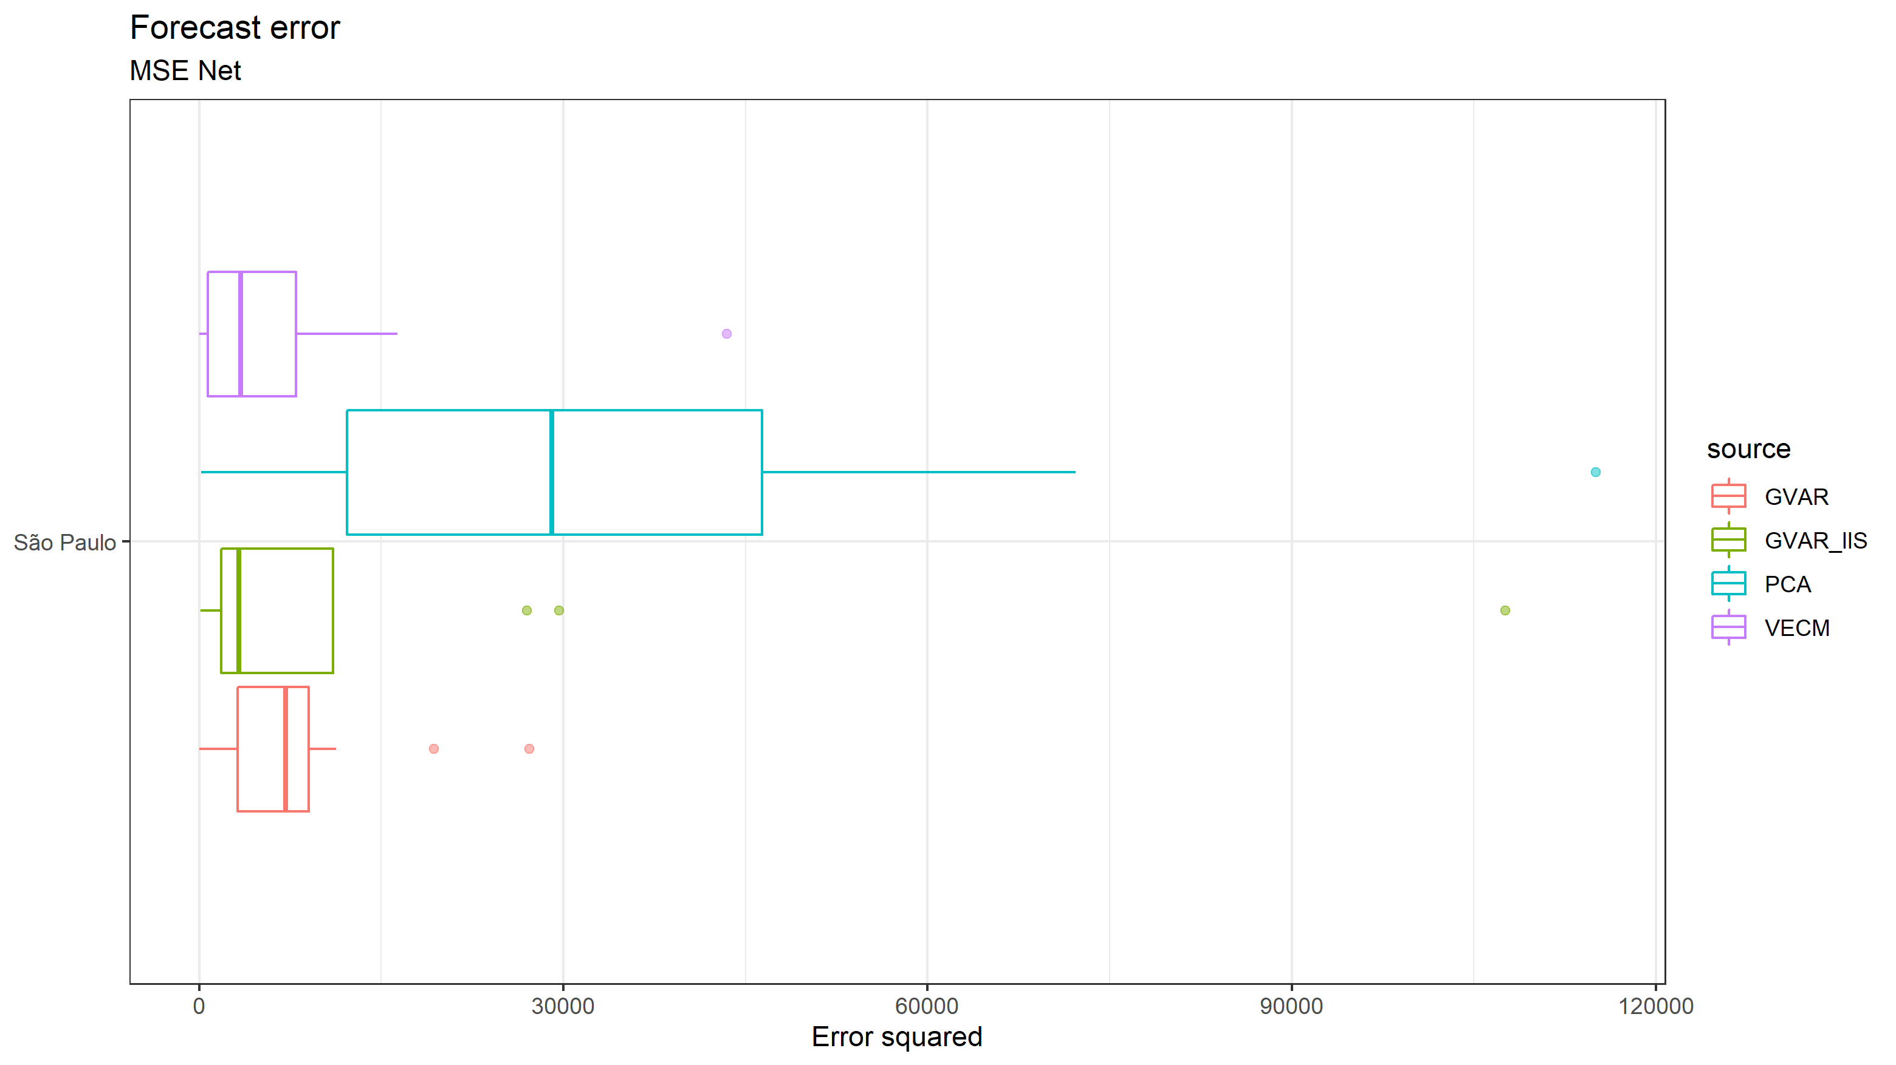

Slide 20
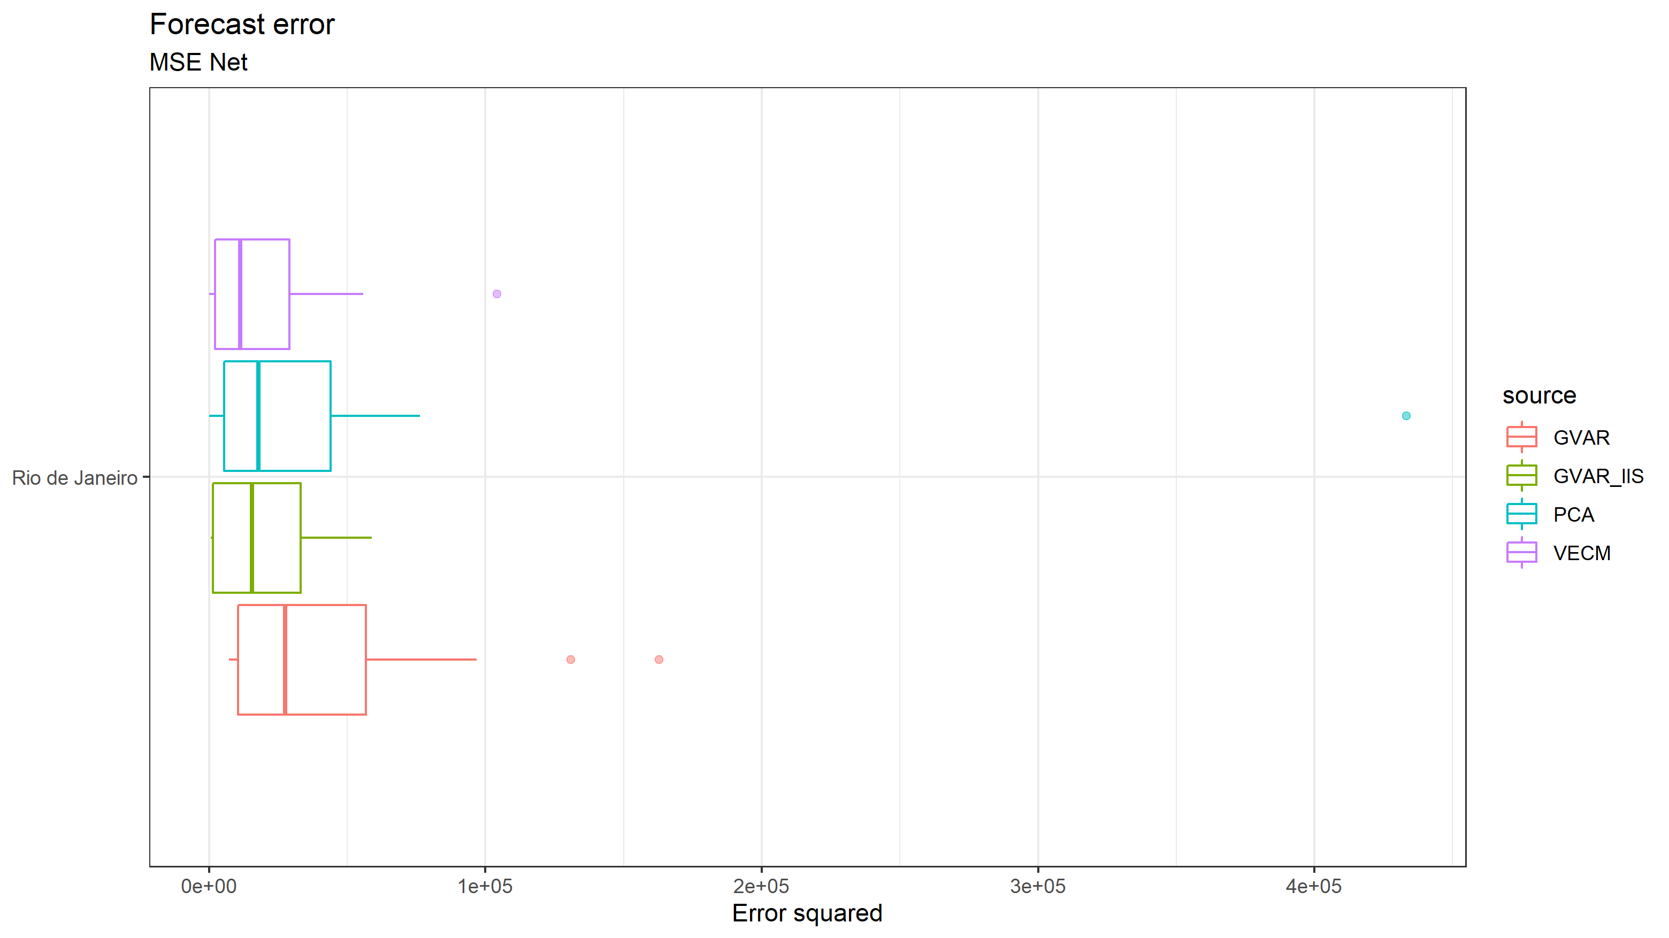

Slide 21
MAE RESULTS

Slide 22
 | PCA | VECM | GVAR | GVAR-IIS
Overall | 467,36 | 299,59* | 380,46 | 314,71
Adm | 500,85 | 328,68* | 399,78 | 330,05
Des | 433,86 | 270,49* | 361,15 | 299,37
Net | 692,21 | 409,24* | 503,40 | 414,71

Slide 23
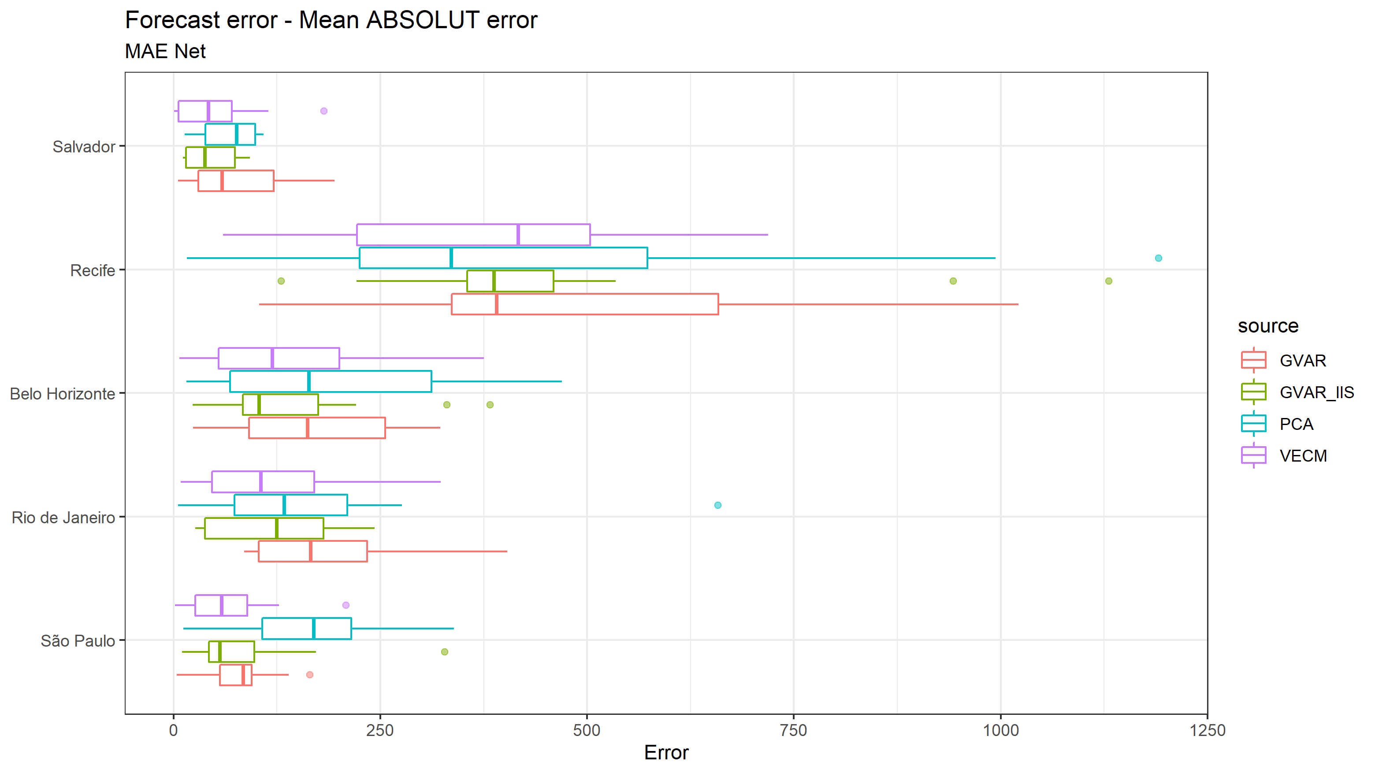

Slide 24
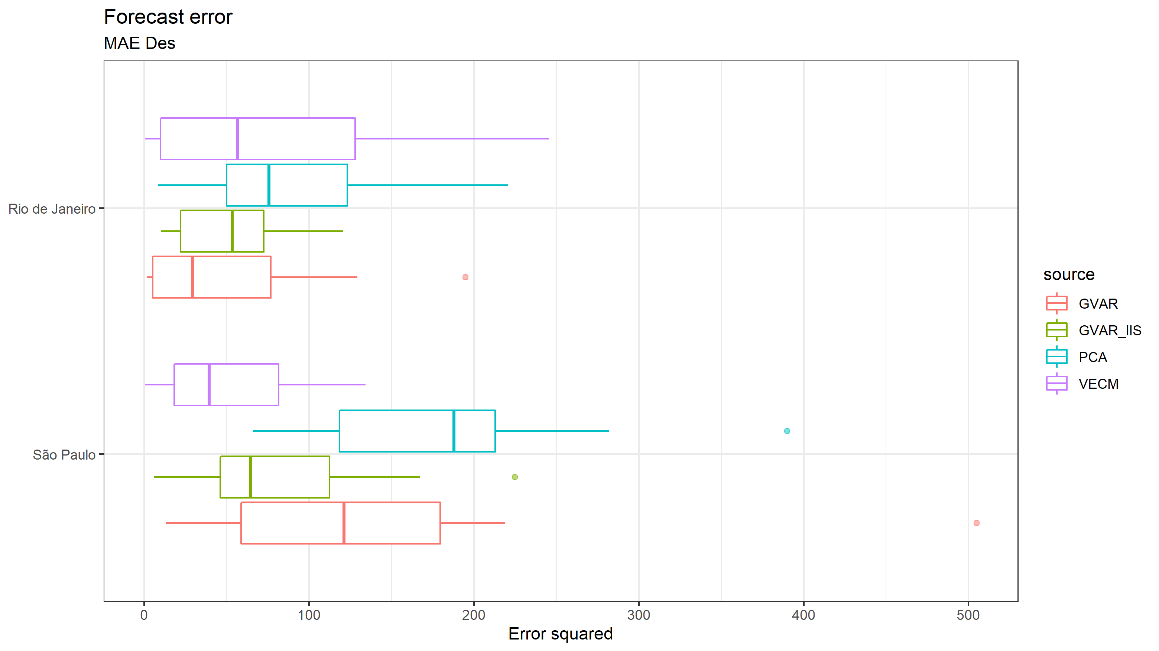

Slide 25
MAE Levando em conta o tamanho do município

Slide 26
 | PCA | VECM | GVAR | GVAR-IIS
Overall | 0.003361 (0.016356) | 0.002163 (0.010604) | 0.002729 (0.011691) | 0.002263 (0.010452)
Adm | 0.003591 (0.018896) | 0.002375 (0.012311) | 0.002857 (0.013183) | 0.002374 (0.011300)
Des | 0.003132 (0.013337) | 0.001951 (0.008560) | 0.002601 (0.009978) | 0.002153 (0.009529)
Net | 0.005030 (0.022846) | 0.002922 (0.012245) | 0.003657 (0.013962) | 0.002933 (0.011366)

Slide 27
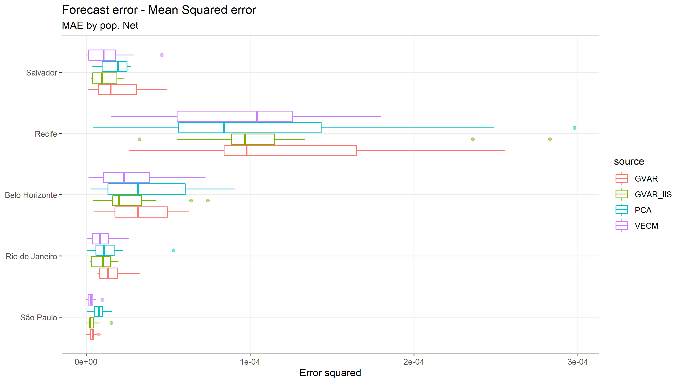

Slide 28
